Slide 1

Multi-level indexing and performance evaluation
Database Management System | Storage Structures, Indexing and Query Optimization
Course: Database Management System (CS-305) | Chapter: Storage Structures, Indexing and Query Optimization | Program: B.TECH-CSE, B.TECH CSE - CYBER SECURITY, B.TECH CSE - DATA
DISCOVER · LEARN · EMPOWER
Notes:
Welcome everyone to today's lecture on Multi-level indexing. We will explore how to handle massive datasets efficiently. This session is crucial for understanding how databases scale beyond single disk pages. Let's begin our journey into advanced storage structures.

Slide 2
Course Outcomes
SLIDE 2 / 14
Course Outcome
CO | BT LEVEL | DESCRIPTION
CO1 | BT2 | Explain database architecture, relational model concepts and formal query language foundations including relational algebra and relational calculus.
CO2 | BT3 | Apply relational algebra, relational calculus and SQL constructs to formulate correct and efficient database queries.
CO3 | BT4 | Analyze functional dependencies and design normalized relational schemas up to 5NF ensuring lossless join and dependency preservation.
CO4 | BT4 | Analyze transaction schedules and concurrency control mechanisms to determine serializability, recoverability and correctness.
CO5 | BT5 | Evaluate storage structures, indexing strategies and query optimization techniques for performance, scalability and reliability.
Chandigarh University
2 / 14
Notes:
Today's lecture directly supports our Course Outcomes. CO2 is addressed as we learn to formulate efficient queries using multi-level indexes. CO3 is relevant because efficient indexing often relies on well-normalized schemas to reduce redundancy. These outcomes ensure you can design both logical and physical layers effectively.

Slide 3
Learning Objectives
SLIDE 3 / 14
Learning Outcomes
1
Define multi-level indexing and explain its necessity for large datasets.
2
Analyze the structure of B+ tree indices and their hierarchical nature.
3
Calculate the number of disk accesses required for a search operation.
4
Evaluate performance metrics comparing single-level versus multi-level indexing.
5
Identify common pitfalls in index maintenance and update overheads.
Chandigarh University
3 / 14
Notes:
By the end of this session, you will be able to define multi-level indexing clearly. You will analyze how B+ trees organize data hierarchically. We will calculate disk accesses to see the math behind the speed. Finally, we will evaluate performance and identify where things can go wrong.

Slide 4
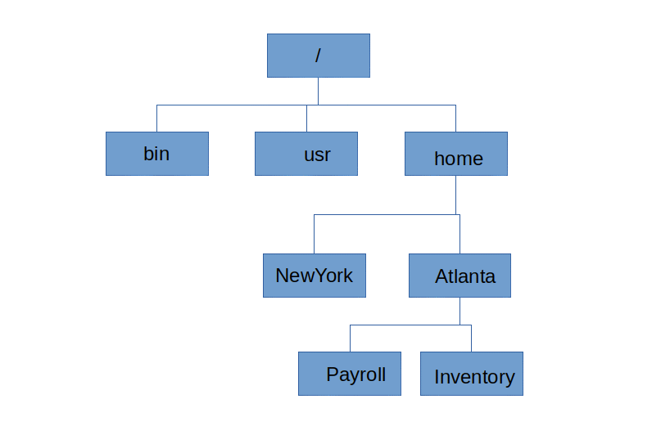
Lecture
SLIDE 4 / 14
Need for Multi-level Indexing
1
Single-level indexes fail when the index file exceeds main memory capacity.
2
Searching a large index requires multiple disk I/O operations sequentially.
3
Multi-level indexing creates a hierarchy to reduce search time logarithmically.
4
The root of the index tree resides in memory for instant access.
5
This structure allows searching millions of records with minimal disk hits.
Hierarchical file system - Wikipedia
Chandigarh University
4 / 14
Notes:
Imagine trying to find a name in a phone book that is larger than your entire library. A single-level index would require scanning too many pages. Multi-level indexing solves this by creating a tree where the top levels fit in memory. This reduces the search time from linear to logarithmic complexity.

Slide 5
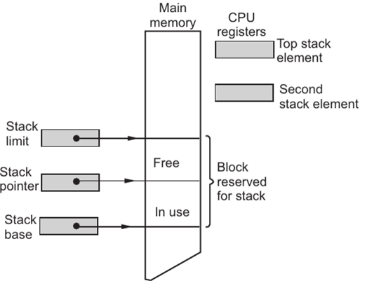
Lecture
SLIDE 5 / 14
Structure of Multi-level Index
1
Level 0 is the data file containing the actual records and pointers.
2
Level 1 is the primary index pointing to blocks of Level 0 data.
3
Level 2 is a sparse index on Level 1, pointing to index blocks.
4
Level k is the root node, typically kept in main memory permanently.
5
Each level reduces the search space by a factor of the block size.
Source: ebrary.net
Chandigarh University
5 / 14
Notes:
Think of this as a library catalog system. Level 0 holds the books, Level 1 holds the card catalog for sections, and Level 2 holds the master index. The root node is like the librarian's desk, always accessible. Each level up reduces the number of blocks you need to check.

Slide 6
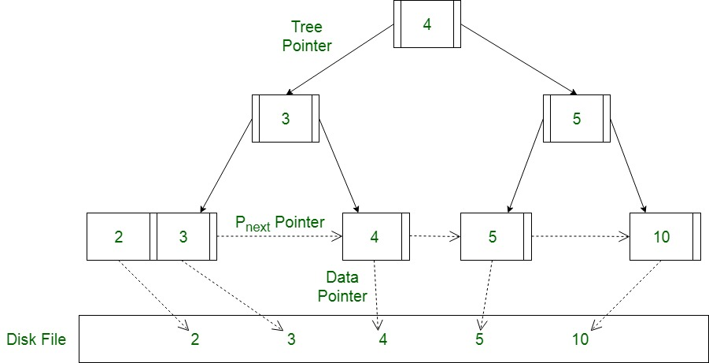
Lecture
SLIDE 6 / 14
B+ Tree as Multi-level Index
1
B+ trees are the most common implementation of multi-level indexing structures.
2
All data pointers reside in the leaf nodes for efficient range queries.
3
Internal nodes contain only search keys and pointers to child nodes.
4
The tree remains balanced, ensuring consistent performance for all operations.
5
Leaf nodes are linked together to support sequential access efficiently.
Source: media.geeksforgeeks.org
Chandigarh University
6 / 14
Notes:
The B+ tree is the industry standard for this purpose. Unlike B-trees, all data pointers are at the bottom, making range scans very fast. Internal nodes act purely as guides to navigate the tree. This balance ensures that no matter how many records you add, the height remains predictable.

Slide 7
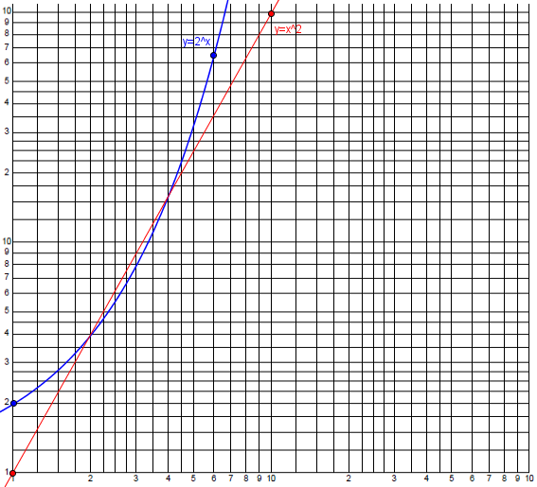
Lecture
SLIDE 7 / 14
Performance Evaluation Metrics
GOVERNING EQUATION
Total cost = (Height of tree) + (Cost of root access)
1
Search cost is measured in the number of disk block accesses required.
2
Insertion cost involves splitting nodes and propagating changes up the tree.
3
Deletion cost requires merging nodes to maintain the minimum fill factor.
4
Performance is evaluated against the logarithm of the number of records.
Source: www.themathdoctors.org
Chandigarh University
7 / 14
Notes:
We measure performance by counting disk accesses, as memory access is negligible. The height of the tree determines the maximum number of disk reads. Insertion and deletion add overhead due to node splitting and merging. Ideally, the cost grows logarithmically with the data size.

Slide 8
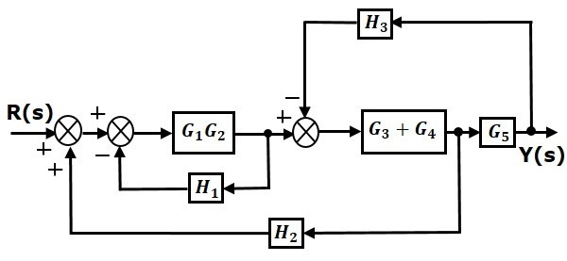
Worked Example
SLIDE 8 / 14
Search Cost
GOVERNING EQUATION
Level 1 index has 10 million / 400 = 25,000 entries
1
Assume 10 million records with 100 bytes each and 8-byte keys.
2
Block size is 4KB, allowing 400 entries per block.
3
Level 2 index has 25,000 / 400 = 63 entries (fits in one block).
4
Search requires 3 disk accesses: Root, Level 2, and Level 1.
Source: www.tutorialspoint.com
Chandigarh University
8 / 14
Notes:
Let's do the math. With 10 million records, a single-level index would be huge. But with multi-level, Level 1 has 25,000 entries. Level 2 only needs 63 entries, fitting in one block. So, finding a record takes just 3 disk reads. This is incredibly fast compared to scanning millions of blocks.

Slide 9
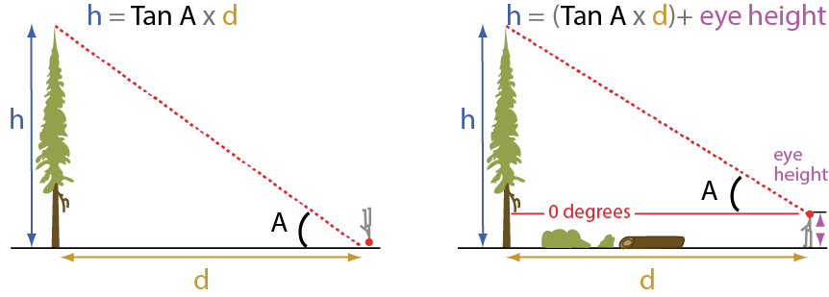
Worked Example
SLIDE 9 / 14
Tree Height
GOVERNING EQUATION
Fanout b = Block Size / (Key Size + Pointer Size)
1
Height h is calculated as log base b of N, where b is fanout.
2
For our example, b = 4000 / (8 + 4) ≈ 333.
3
Height h = log_333(10,000,000) ≈ 3.5, rounded up to 4 levels.
4
This confirms the search depth is minimal even for massive datasets.
Source: bigtreesreg.sites.olt.ubc.ca
Chandigarh University
9 / 14
Notes:
The height formula is crucial for capacity planning. We calculate the fanout based on how many keys fit in a block. For our example, the fanout is 333. Taking the log base 333 of 10 million gives us a height of roughly 4. This mathematical proof confirms our manual calculation of 3-4 disk accesses.

Slide 10
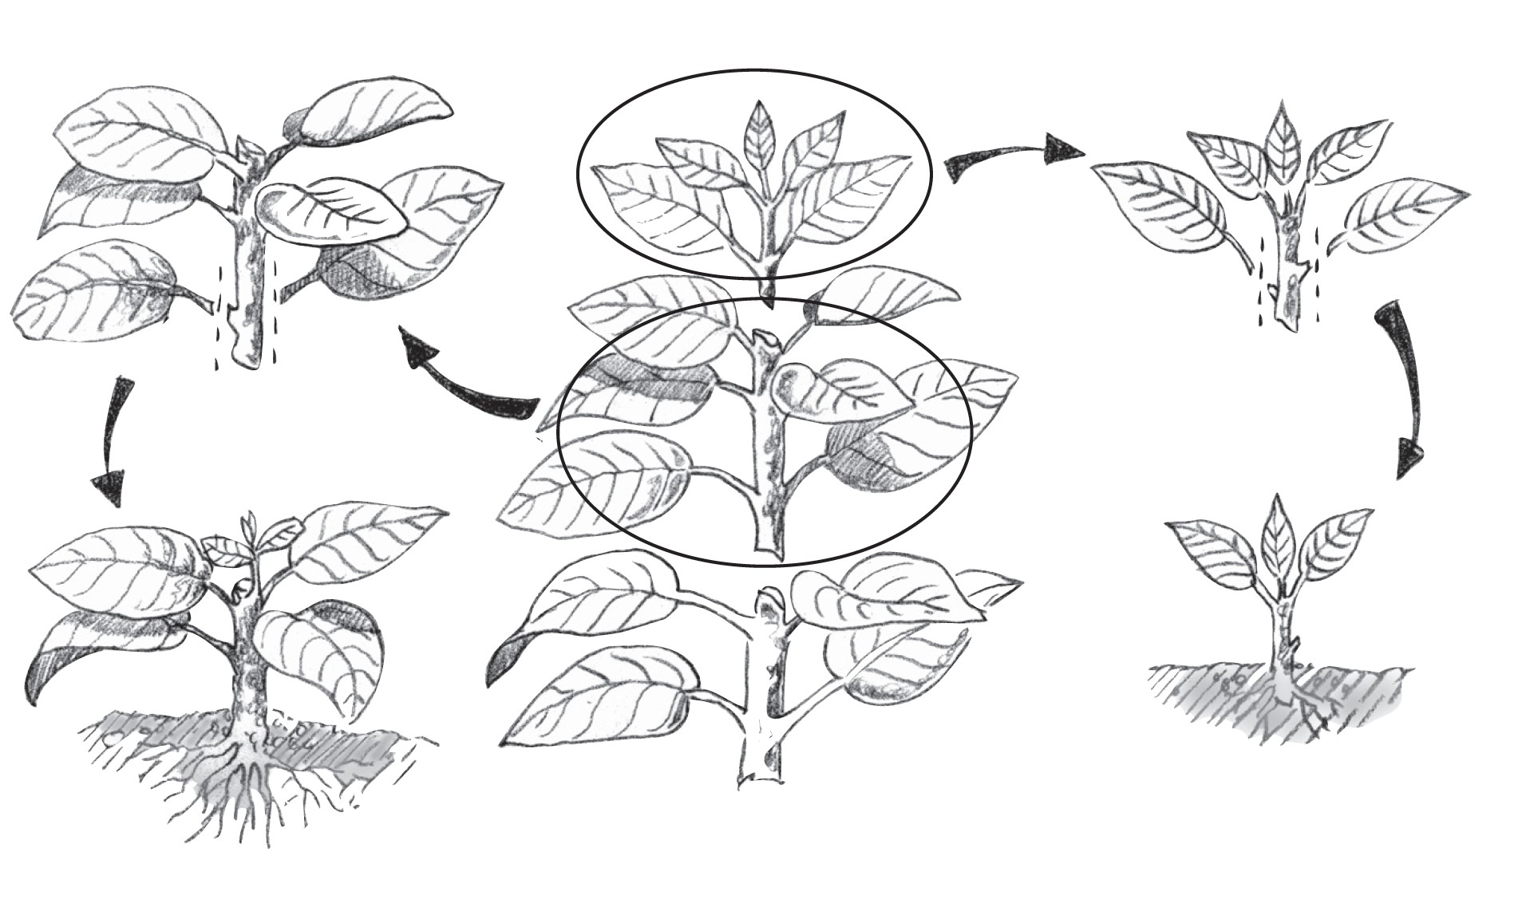
Lecture
SLIDE 10 / 14
Impact of Updates on Performance
1
Inserting a record may trigger a node split if the block is full.
2
Node splits propagate upwards, potentially increasing the tree height.
3
Deletion may cause underflow, requiring node merging or redistribution.
4
Frequent updates degrade performance due to increased I/O operations.
5
Rebalancing ensures the tree remains balanced after every modification.
Source: www.pubs.ext.vt.edu
Chandigarh University
10 / 14
Notes:
Updates are the hidden cost of indexing. When a block fills up, it splits, creating a new node. This can ripple up to the root, increasing the tree height. Deletions can cause underflow, forcing us to merge nodes. These operations require extra disk writes, slowing down the system during heavy updates.

Slide 11
Lecture
SLIDE 11 / 14
Common Pitfalls in Indexing
1
Creating too many indexes slows down write operations significantly.
2
Ignoring selectivity leads to indexes that are less efficient than scans.
3
Poor key selection results in high fanout and deeper trees.
4
Not updating statistics causes the query optimizer to choose wrong paths.
5
Over-indexing consumes excessive disk space and memory resources.
Chandigarh University
11 / 14
Notes:
There are common mistakes students make. Creating too many indexes is a major pitfall; it speeds up reads but kills write performance. Also, indexing low-selectivity columns like 'Gender' is often useless. You must balance the benefits of faster reads against the cost of maintaining these structures.

Slide 12
Lecture
SLIDE 12 / 14
Query Optimization Role
1
The query optimizer uses index statistics to choose the best access path.
2
It compares the cost of index scan versus full table scan.
3
Multi-level indexes allow random access to specific data ranges quickly.
4
Optimizers prefer indexes when the selectivity of the query is high.
5
Without indexes, the optimizer defaults to a sequential scan of all data.
Chandigarh University
12 / 14
Notes:
The query optimizer is the brain behind the scenes. It decides whether to use your multi-level index or just scan the whole table. It uses statistics to estimate the cost. If you query for a rare value, the index is the clear winner. If you query for 50% of the data, a scan might be faster.

Slide 13
Lecture
SLIDE 13 / 14
Key Takeaways
1
Multi-level indexing reduces search time from linear to logarithmic complexity.
2
B+ trees are the preferred structure due to their balanced nature and leaf linking.
3
Performance is measured by disk accesses, which depend on tree height.
4
Updates incur overhead due to node splitting and merging operations.
5
Effective indexing requires balancing read speed with write costs and space.
Chandigarh University
13 / 14
Notes:
To summarize, multi-level indexing is essential for large databases. B+ trees provide the best balance of speed and structure. Remember that performance is all about minimizing disk accesses. Finally, always consider the trade-off between read speed and write overhead when designing your schema.

Slide 14
Lecture
SLIDE 14 / 14
References
1
Fundamentals of Database Systems — Ramez Elmasri & Shamkant B. Navathe
2
Database System Concepts — Silberschatz, Korth & Sudarshan
3
Database Management Systems — Raghu Ramakrishnan & Johannes Gehrke
4
Oracle/MySQL Documentation — Oracle
Chandigarh University
14 / 14
Notes:
These are the standard texts you should consult for deeper understanding. Elmasri and Navathe provide excellent theoretical foundations. Silberschatz offers a practical approach to system concepts. Ramakrishnan is great for query optimization details. Please refer to the Oracle documentation for specific implementation details.

